Slide 1


Department of Computer Science and Engineering
FACIAL EXPRESSION RECOGNITION
FOR HUMAN COMPUTER INTERACTION
Dr. P. Kumar, M.E., Ph.D.,
Professor and Supervisor
Team ID: B21A2425C15
Pratheepa R – 210701192
Mannuru Shreeya - 210701148

Slide 2
Problem Statement and Motivation
Human-computer interaction is very vital in today’s era of technology. Enhancing the methodologies and bringing out innovations in the ways in which a computer interacts with a human is important in order to facilitate effective communication and improve user experience.
In what all ways can we improve the user experience?
Can that be improved by recognizing facial expressions of the user?

Slide 3
Objectives
The objective of the project is to develop a learning assistant
The assistant must be able to dynamically adjust its responses based on facial expressions of the user
Recognize facial expressions of the user accurately
Provide the user with the required information
Improve user experience
Enhance the learning efficiency of the user

Slide 4
Abstract
Facial expressions are very important in understanding one's state of mind. We aim to incorporate this notion in our learning assistant application in order to provide a rich user experience. The facial expression of the user is recognized with the help of a model trained on the FER dataset using a convolutional neural network. The facial expressions of the user are continuously monitored, and the frames are sent to the server-side scripting for classification. The model classifies each frame into one of the seven classes: happy, sad, surprise, neutral, angry, fear, and disgust. If the interpretation is such that the user is enthusiastic about the concept and the delivered response, more information would be gathered and displayed for the user. Else, a much simpler version of the concept is provided as a modified response in order to facilitate the user in understanding the displayed content. This improves the learning experience for the user by providing personalized responses in real-time.

Slide 5
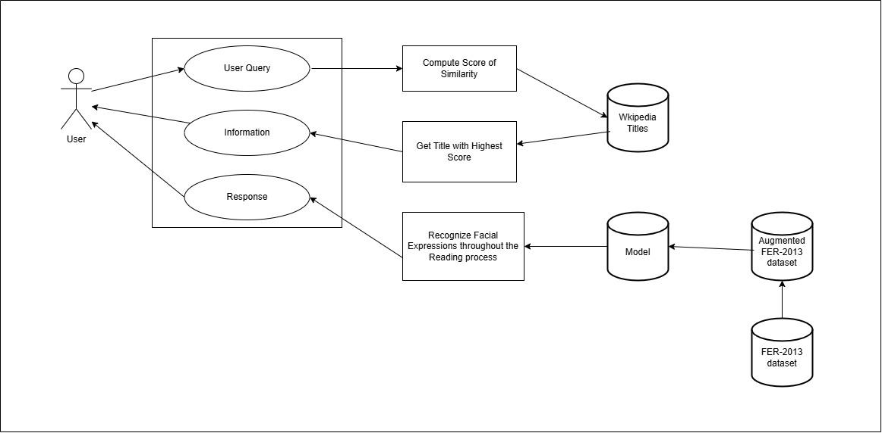
System Architecture

Slide 6
System Architecture
The system inputs a user query and finds the relevant Wikipedia title that has the maximum similarity with the query. It retrieves the content of the matched title and displays the information. A model is trained on the augmented FER-2013 dataset using a convolutional neural network to recognize facial expressions. When the content is displayed, the webcam starts capturing images every 2 seconds while the user is reading. The system predicts the user's emotion for every frame and identifies the predominant expression of the user by giving less weightage to the first half of the predictions and more weightage to the second half of the predictions. It displays suitable responses based on the predominant expression of the user throughout the learning process.

Slide 7
List of Modules
Information Providing Module
Facial Expression Recognition Module

Slide 8
Information Providing Module
The Information Providing Module handles the entire process of processing user queries and retrieving relevant content. When a user submits a natural language query, the system first performs text processing to prepare the query for matching against the actual Wikipedia titles by removing the special characters. The processed query is then compared against the list of Wikipedia titles, where a custom algorithm evaluates the similarity between the query and each title by computing a score based on matching words between the query and titles. After identifying the title that gets the maximum score, the corresponding content is retrieved and presented for the user. If the system cannot find a closely matching title, it prompts the user for a more specific query.

Slide 9
Facial Expression Recognition Module
The Facial Expression Recognition module is responsible for detecting and interpreting the user's emotions while interacting with the system. It uses convolutional neural network trained on an augmented FER-2013 dataset. It is used to detect seven basic emotions: happy, sad, angry, fear, disgust, surprise, and neutral. The model takes images captured from the webcam every 2 seconds while the user is reading the content displayed, analyzing each frame to predict the user’s predominant emotion. The module weighs predictions from the first half and second half of the interaction differently, giving more importance to the latter frames to identify the user’s final emotional state. Based on the detected emotion, the system displays an appropriate message.

Slide 10
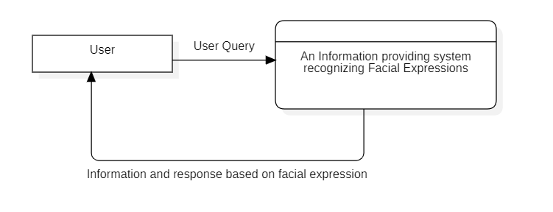
Data Flow Diagram Level - 0

Slide 11
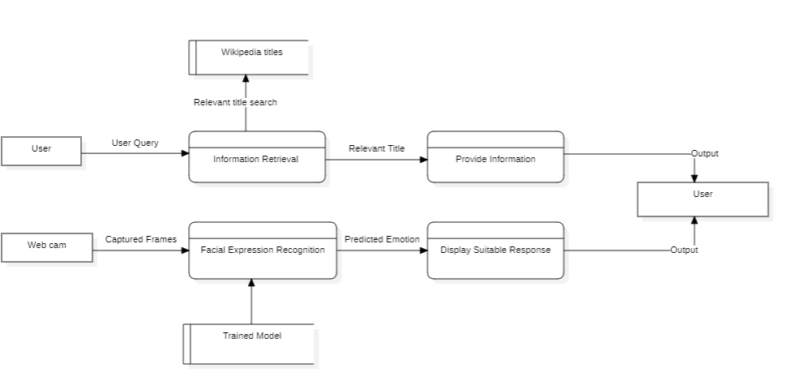
Data Flow Diagram Level - 1

Slide 12
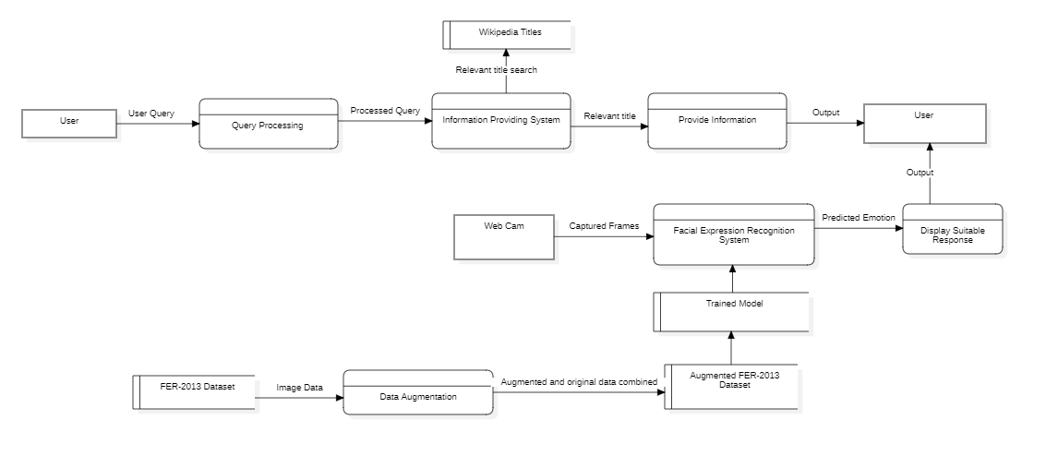
Data Flow Diagram Level - 2

Slide 13
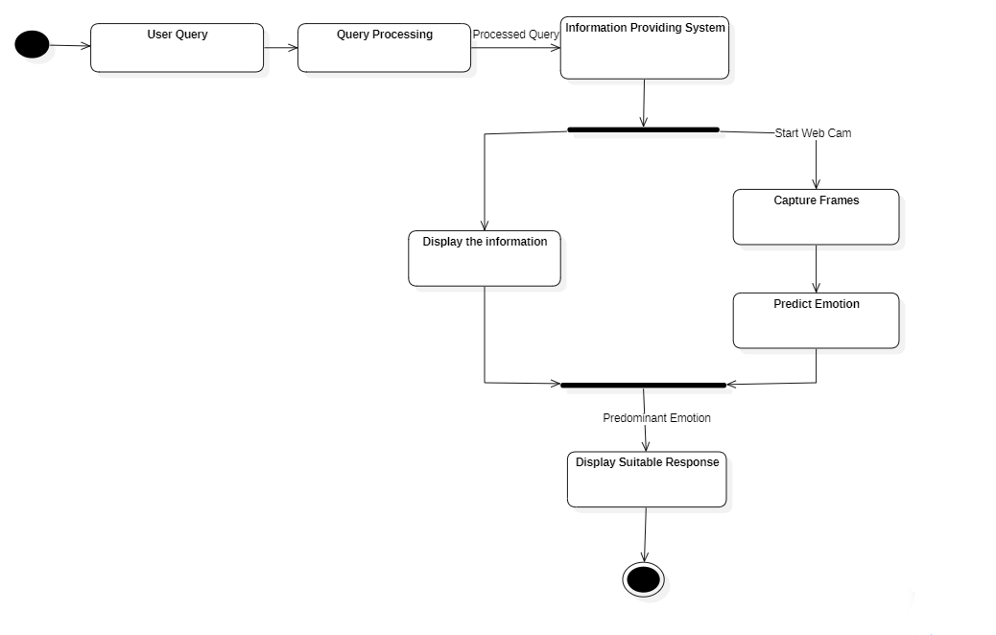
Activity Diagram

Slide 14
Implementation
The project has implemented two main components: information providing system and facial expression recognition system. The information providing system inputs a user query and matches the query with a title from the list of Wikipedia titles that attains the highest score of similarity with the query. The corresponding information is retrieved using the wikipedia module and displayed for the user. While displaying the content, the facial expression recognition system acts simultaneously by capturing frames every two seconds and predicting the expression of the user for every frame to find the predominant expression throughout the learning process. The expressions of the user in the latter part of the time period are given more importance. Using the predominant expression, suitable responses are displayed for the user.

Slide 15
Results
The proposed model has recorded an accuracy of 65.11% in recognizing facial expressions from 7178 unseen images. The training dataset is split into 80% training data and 20% validation data with the training being performed on the training data and the accuracy and loss being monitored on the unseen validation data. Initially both the training accuracy and validation accuracy seem to be of the same values with the validation accuracy even recording a higher accuracy at some stages. As the training progresses, the model starts to extensively learn the training data and therefore, the training accuracy keeps on increasing than the validation accuracy. The training stops with 34 epochs as the validation loss does not decrease for 10 consecutive epochs and the model is saved with the best weights that have been achieved so far to get to the minimum possible loss value.

Slide 16
Conclusion & Work for Phase II
The project aims to not only provide the requested information but also recognize the facial expressions of the user while reading through the provided content. The predominant expression of the user throughout the learning process is used to provide suitable responses and can be used to adapt the content so as to cater to the needs or expectations of the user. The systems aims to improve the user experience and also the learning efficiency of the user. We aim to provide the functionality of modifying the provided information based on the facial expressions of the user and improve the accuracy of the model to recognize facial expressions in real-time.

Slide 17
References
[1] M. Aly, A. Ghallab and I. S. Fathi, "Enhancing Facial Expression Recognition System in Online Learning Context Using Efficient Deep Learning Model," in IEEE Access, vol. 11, pp. 121419-121433, 2023, doi: 10.1109/ACCESS.2023.3325407.
[2] W. E. Villegas-Ch, J. García-Ortiz and S. Sánchez-Viteri, "Identification of Emotions From Facial Gestures in a Teaching Environment With the Use of Machine Learning Techniques," in IEEE Access, vol. 11, pp. 38010-38022, 2023, doi: 10.1109/ACCESS.2023.3267007.
[3] G. Zhao, H. Yang and M. Yu, "Expression Recognition Method Based on a Lightweight Convolutional Neural Network," in IEEE Access, vol. 8, pp. 38528-38537, 2020, doi: 10.1109/ACCESS.2020.2964752.

Slide 18
References
[4] J. Liu, H. Wang and Y. Feng, "An End-to-End Deep Model With Discriminative Facial Features for Facial Expression Recognition," in IEEE Access, vol. 9, pp. 12158-12166, 2021, doi: 10.1109/ACCESS.2021.3051403.
[5] N. Zhou, R. Liang and W. Shi, "A Lightweight Convolutional Neural Network for Real-Time Facial Expression Detection," in IEEE Access, vol. 9, pp. 5573-5584, 2021, doi: 10.1109/ACCESS.2020.3046715.
[6] J. Pu and X. Nie, "Convolutional Channel Attentional Facial Expression Recognition Network and Its Application in Human–Computer Interaction," in IEEE Access, vol. 11, pp. 129412-129424, 2023, doi: 10.1109/ACCESS.2023.3333381.

Slide 19
References
[7] P. Ganesan, S. Kumar Jagatheesaperumal, I. Gobhinath, V. Venkatraman, S. N. Gaftandzhieva and R. Z. Doneva, "Deep Learning-Based Interactive Dashboard for Enhancing Online Classroom Experience Through Student Emotion Analysis," in IEEE Access, vol. 12, pp. 91140-91153, 2024, doi: 10.1109/ACCESS.2024.3421282.
[8] M. D’incà, C. Beyan, R. Niewiadomski, S. Barattin and N. Sebe, "Unleashing the Transferability Power of Unsupervised Pre-Training for Emotion Recognition in Masked and Unmasked Facial Images," in IEEE Access, vol. 11, pp. 90876-90890, 2023, doi: 10.1109/ACCESS.2023.3308047.
[9] M. Shi, L. Xu and X. Chen, "A Novel Facial Expression Intelligent Recognition Method Using Improved Convolutional Neural Network," in IEEE Access, vol. 8, pp. 57606-57614, 2020, doi: 10.1109/ACCESS.2020.2982286.

Slide 20
References
[10] E. Uzun, "A Novel Web Scraping Approach Using the Additional Information Obtained From Web Pages," in IEEE Access, vol. 8, pp. 61726-61740, 2020, doi: 10.1109/ACCESS.2020.2984503.
[11] G. Suddul, C. Lillmond and S. Armoogum, "A Smart Virtual Tutor with Facial Emotion Recognition for Online Learning," 2022 IEEE Zooming Innovation in Consumer Technologies Conference (ZINC), Novi Sad, Serbia, 2022, pp. 67-72, doi: 10.1109/ZINC55034.2022.9840683.
[12] B. Fang, X. Li, G. Han and J. He, "Facial Expression Recognition in Educational Research From the Perspective of Machine Learning: A Systematic Review," in IEEE Access, vol. 11, pp. 112060-112074, 2023, doi: 10.1109/ACCESS.2023.3322454.

Slide 21
References
[13] A. V. Savchenko, L. V. Savchenko and I. Makarov, "Classifying Emotions and Engagement in Online Learning Based on a Single Facial Expression Recognition Neural Network," in IEEE Transactions on Affective Computing, vol. 13, no. 4, pp. 2132-2143, 1 Oct.-Dec. 2022, doi: 10.1109/TAFFC.2022.3188390.
[14] R. Miao, H. Kato, Y. Hatori, Y. Sato and S. Shioiri, "Analysis of Facial Expressions to Estimate the Level of Engagement in Online Lectures," in IEEE Access, vol. 11, pp. 76551-76562, 2023, doi: 10.1109/ACCESS.2023.3297651.
[15] R. Bhargava, R. Lobo, R. Shah, N. Shah and S. Nair, "Easier Web Navigation Using Intent Classification, Web Scraping and NLP Approaches," 2022 5th International Conference on Advances in Science and Technology (ICAST), Mumbai, India, 2022, pp. 286-290, doi: 10.1109/ICAST55766.2022.10039559.

Slide 22
References
[16] Y. He, Y. Zhang, S. Chen and Y. Hu, "Facial Expression Recognition Using Hierarchical Features With Three-Channel Convolutional Neural Network," in IEEE Access, vol. 11, pp. 84785-84794, 2023, doi: 10.1109/ACCESS.2023.3303402.
[17] D. -H. Lee and J. -H. Yoo, "CNN Learning Strategy for Recognizing Facial Expressions," in IEEE Access, vol. 11, pp. 70865-70872, 2023, doi: 10.1109/ACCESS.2023.3294099.
[18] Y. Tang, X. Zhang, X. Hu, S. Wang and H. Wang, "Facial Expression Recognition Using Frequency Neural Network," in IEEE Transactions on Image Processing, vol. 30, pp. 444-457, 2021, doi: 10.1109/TIP.2020.3037467.

Slide 23
References
[19] S. Li, X. Li, L. Shang, X. Jiang, Q. Liu, C. Sun, Z. Ji and B. Liu, “HopRetriever: Retrieve Hops over Wikipedia to Answer Complex Questions”, AAAI, vol. 35, no. 15, pp. 13279-13287, May 2021.
[20] X. Yang, Y. Fang and C. Raga Rodolfo, "Graph Convolutional Neural Networks for Micro-Expression Recognition—Fusion of Facial Action Units for Optical Flow Extraction," in IEEE Access, vol. 12, pp. 76319-76328, 2024, doi: 10.1109/ACCESS.2024.3406037.

Slide 24
Paper Publication Status
PUBLICATION STATUS : IN REVIEW PROCESS
TITLE OF THE PAPER : AN APPROACH TO DEVELOP THE INFORMATION PROVIDING SYSTEM BY RECOGNIZING FACIAL EXPRESSIONS
AUTHORS : DR. P. KUMAR, DR. SENTHIL PANDI S, PRATHEEPA R, MANNURU SHREEYA
NAME OF THE CONFERENCE :INTERNATIONAL CONFERENCE ON ADVANCES IN COMPUTER SCIENCE, ELECTRICAL, ELECTRONICS, AND COMMUNICATION TECHNOLOGIES

Slide 25
Thank You

